Slide 1
Chapter 6
How to code methods and event handlers

Slide 2
Objectives (part 1)
Applied
Given the specifications for a method, write the method.
Give the documentation for a method including its signature, use the method.
Give a portion of code that can be converted to a method call and a method, use refactoring to do the conversion.

Slide 3
Objectives (part 2)
Knowledge
Describe the signature of a method.
Describe an expression-bodied method.
Explain the difference between passing an argument by value and by reference.
Describe the use of optional arguments.
Describe the advantages of passing arguments by name.
Describe the use of a tuple as the return type of a method.
In general terms, describe the way event wiring works in C#, what you need to do to delete an event, and how you can use one event handler to handle two or more events.

Slide 4
The basic syntax for coding a method
{public|private} returnType MethodName([parameterList])
{
statements }
A method with no parameters and no return type
private void DisableButtons()
{
btnCalculate.Enabled = false;
btnExit.Enabled = false;
}

Slide 5
A method with one parameter that returns a decimal value
private decimal GetDiscountPercent(decimal subtotal)
{
decimal discountPercent = 0m;
if (subtotal >= 500)
discountPercent = .2m;
else
discountPercent = .1m;
return discountPercent;
}

Slide 6
A method with three parameters that returns a decimal value
private decimal CalculateFutureValue(
decimal monthlyInvestment,
decimal monthlyInterestRate, int months)
{
decimal futureValue = 0m;
for (int i = 0; i < months; i++)
{
futureValue = (futureValue + monthlyInvestment)
* (1 + monthlyInterestRate);
}
return futureValue;
}

Slide 7
The syntax for calling a method
[this.]MethodName([argumentList])
A statement that calls a method that has no parameters
this.DisableButtons();
A statement that passes one argument
decimal discountPercent = this.GetDiscountPercent(subtotal);
A statement that passes three arguments
decimal futureValue = CalculateFutureValue(
monthlyInvestment, monthlyInterestRate, months);

Slide 8
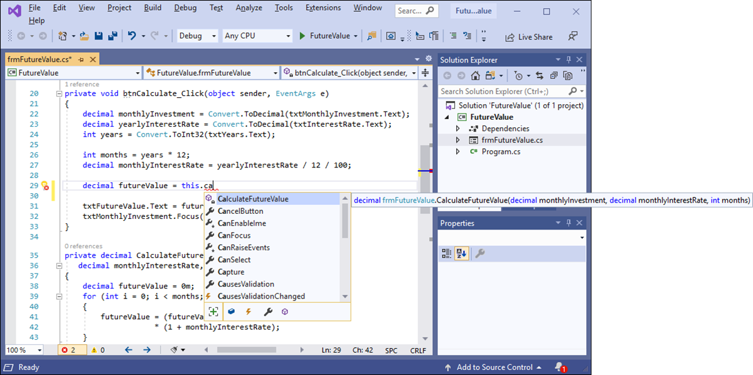
The IntelliSense feature for calling a method

Slide 9
The syntax for an optional parameter
type parameterName = defaultvalue
The GetFutureValue() method with two optional parameters
private decimal GetFutureValue(decimal monthlyInvestment,
decimal monthlyInterestRate = 0.05m, int months = 12)
{
decimal futureValue = 0m;
for (int i = 0; i < months; i++)
{
futureValue = (futureValue + monthlyInvestment) *
(1 + monthlyInterestRate);
}
return futureValue;
}

Slide 10
A statement that passes arguments for all three parameters to the function
decimal futureValue =
this.GetFutureValue(monthlyInvestment,
monthlyInterestRate, months);
A statement that omits the argument for the third parameter
decimal futureValue =
this.GetFutureValue(monthlyInvestment,
monthlyInterestRate);

Slide 11
Two statements that pass the arguments for two parameters by name
decimal futureValue =
this.GetFutureValue(monthlyInvestment:monthlyInvestment,
months:months);
decimal futureValue =
this.GetFutureValue(months:months,
monthlyInvestment:monthlyInvestment);
A statement that passes one argument by position and one by name
decimal futureValue =
this.GetFutureValue(monthlyInvestment, months:months);

Slide 12
A method that executes a single statement
private void DisplayErrorMessage(string message, string caption)
{
MessageBox.Show(message, caption);
}
The same method with an expression body
private void DisplayErrorMessage(string message, string caption) => MessageBox.Show(message, caption);

Slide 13
A method that returns the value of an expression
private decimal GetDiscountPercent(string customerType)
{
return customerType switch
{
"R" => .1m,
"C" => .2m,
"T" => .4m,
_ => .0m
};
}
The same method with an expression body
private decimal GetDiscountPercent(string customerType) =>
customerType switch
{
"R" => .1m,
"C" => .2m,
"T" => .4m,
_ => .0m
};

Slide 14
The btnCalculate_Click() method with selected statements
private void btnCalculate_Click(object sender, EventArgs e)
{
decimal monthlyInvestment =
Convert.ToDecimal(txtMonthlyInvestment.Text);
decimal yearlyInterestRate =
Convert.ToDecimal(txtInterestRate.Text);
int years = Convert.ToInt32(txtYears.Text);
int months = years * 12;
decimal monthlyInterestRate = yearlyInterestRate / 12 / 100;
decimal futureValue = 0m;
for (int i = 0; i < months; i++)
{
futureValue = (futureValue + monthlyInvestment)
* (1 + monthlyInterestRate);
}
txtFutureValue.Text = futureValue.ToString("c");
txtMonthlyInvestment.Focus();
}

Slide 15
The method call that replaces the selected code
decimal futureValue = CalculateFutureValue(
monthlyInvestment, months, monthlyInterestRate);
The method that’s added to the class
private static decimal CalculateFutureValue(
decimal monthlyInvestment, int months,
decimal monthlyInterestRate)
{
decimal futureValue = 0m;
for (int i = 0; i < months; i++)
{
futureValue = (futureValue + monthlyInvestment)
* (1 + monthlyInterestRate);
}
return futureValue;
}

Slide 16
How to use refactoring to create a new method from existing code
Select the code you want to create a new method from, press Ctrl + period (.), and select Extract Method from the Quick Actions menu that’s displayed. This adds a method named NewMethod() to the class, replaces the selected code with a statement that calls the method, and displays the Rename dialog box for the method name.
Enter the name that you want to use for the new method and click the Apply button.

Slide 17
The basic syntax of the parameters in a parameter list
[{ref|out|in}] type variableName
A CalculateFutureValue() method that uses the ref keyword
private void CalculateFutureValue( decimal monthlyInvestment,
decimal monthlyInterestRate, int months,
ref decimal futureValue)
{
for (int i = 0; i < months; i++)
{
futureValue = (futureValue + monthlyInvestment)
* (1 + monthlyInterestRate);
}
}

Slide 18
Three statements that work with the CalculateFutureValue() method
decimal futureValue = 0m;
this.CalculateFutureValue(monthlyInvestment,
monthlyInterestRate, months, ref futureValue);
txtFutureValue.Text = futureValue.ToString("c");

Slide 19
A CalculateFutureValue() method that uses the out keyword (C# 6.0 and later)
private void CalculateFutureValue(
decimal monthlyInvestment,
decimal monthlyInterestRate, int months,
out decimal futureValue)
{
for (int i = 0; i < months; i++)
{
futureValue = (futureValue + monthlyInvestment)
* (1 + monthlyInterestRate);
}
}

Slide 20
Two statements that work with the CalculateFutureValue() method
decimal futureValue;
this.CalculateFutureValue(monthlyInvestment,
monthlyInterestRate, months, out futureValue);
Another way to work with this method (C# 7.0 and later)
this.CalculateFutureValue(monthlyInvestment,
monthlyInterestRate, months,
out decimal futureValue);

Slide 21
A CalculateFutureValue() method that uses the in keyword (C# 7.2 and later)
private void CalculateFutureValue(
in decimal monthlyInvestment,
in decimal monthlyInterestRate,
in int months, out decimal futureValue)
{
for (int i = 0; i < months; i++)
{
futureValue = (futureValue + monthlyInvestment)
* (1 + monthlyInterestRate);
}
}
A statement that calls this method
this.CalculateFutureValue(monthlyInvestment,
monthlyInterestRate, months,
out decimal futureValue);

Slide 22
How to create and work with an unnamed tuple
How to create a tuple with two members
var person = ("Anne Boehm", 62);
How to refer to the members of the tuple
person.Item1
person.Item2
How to create and work with a named tuple
How to create a tuple with two members
var person = (Name: "Anne Boehm", Age: 62);
How to create the tuple and declare its member types
(string Name, int Age) person = ("Anne Boehm", 62);
How to refer to the members of the tuple
person.Name
person.Age

Slide 23
How to create a tuple using variable names (C# 7.1 and later)
How to create a tuple with two members
string name = "Anne Boehm";
int age = 62;
var person = (name, age);
How to refer to the members of the tuple
person.name
person.age

Slide 24
A CalculateFutureValue() method that returns a tuple
private (decimal FutureValue, decimal TotalInterest)
CalculateFutureValue(decimal monthlyInvestment,
decimal monthlyInterestRate, int months)
{
decimal futureValue = 0m;
decimal totalInterest = 0m;
decimal monthlyInterest = 0m;
for (int i = 0; i < months; i++)
{
monthlyInterest =
(futureValue + monthlyInvestment)
* monthlyInterestRate;
totalInterest += monthlyInterest;
futureValue += monthlyInvestment
+ monthlyInterest;
}
return (futureValue, totalInterest);
}

Slide 25
A statement that calls the CalculateFutureValue() method and deconstructs the tuple
(decimal FutureValue, decimal TotalInterest) =
this.CalculateFutureValue(monthlyInvestment,
monthlyInterestRate,
months);
Statements that refer to the members of the tuple
txtFutureValue.Text = FutureValue.ToString("c");
txtTotalInterest.Text = TotalInterest.ToString("c");

Slide 26
A statement that calls the CalculateFutureValue() method and assigns the tuple to a variable
var calculations = this.CalculateFutureValue(
monthlyInvestment, monthlyInterestRate, months);
Statements that refer to the members of the tuple
txtFutureValue.Text =
calculations.FutureValue.ToString("c");
txtTotalInterest.Text =
calculations.TotalInterest.ToString("c");

Slide 27
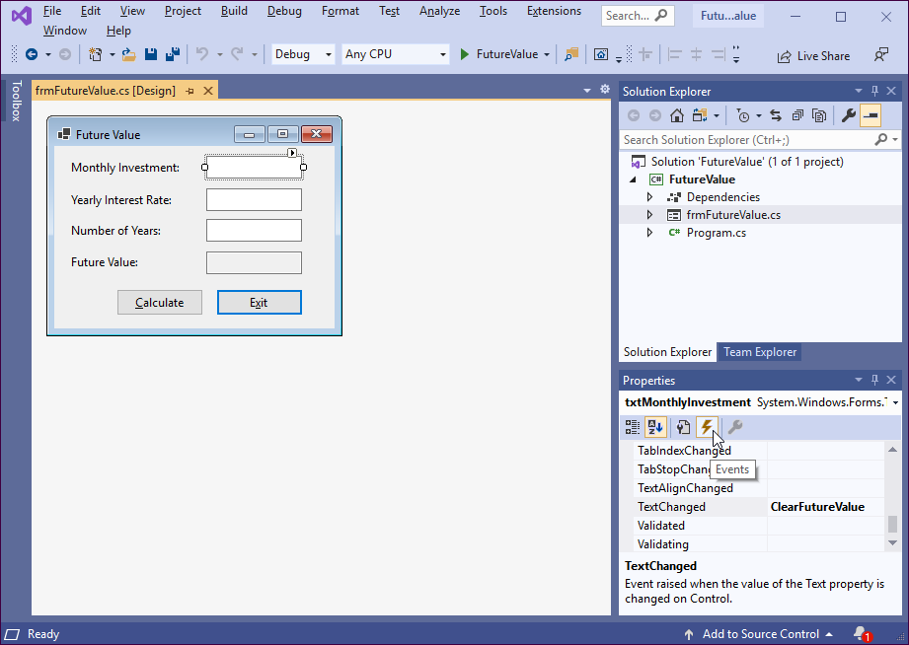
The Events list for a text box control

Slide 28
The default event handler for a text box
The method declaration for the event handler
private void txtMonthlyInvestment_TextChanged(
object sender, EventArgs e)
{
}
The generated statement that wires the event to the event handler
this.txtMonthlyInvestment.TextChanged
+= new System.EventHandler(
this.txtMonthlyInvestment_TextChanged);

Slide 29
A custom event handler for a text box
The method declaration for the event handler
private void ClearFutureValue(object sender, EventArgs e)
{
}
The generated statement that wires the event to the event handler
this.txtMonthlyInvestment.TextChanged +=
new System.EventHandler(this.ClearFutureValue);

Slide 30
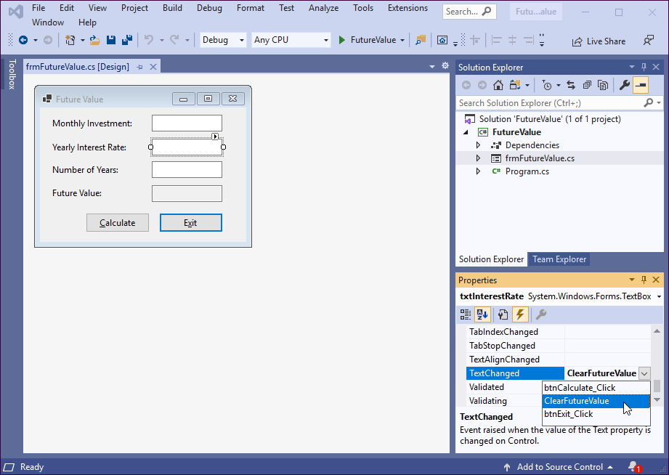
How to select an existing event handler for an event

Slide 31
How to wire an event to an existing event handler
Select the control in the Form Designer.
If necessary, click the Events button in the Properties window to display a list of the events for the control.
Click to the right of the event you want to handle and display the drop-down list.
Select the event handler you want to use for that event.

Slide 32
The code for the methods for the Future Value application (part 1)
private void btnCalculate_Click(object sender, EventArgs e)
{
decimal monthlyInvestment =
Convert.ToDecimal(txtMonthlyInvestment.Text);
decimal yearlyInterestRate =
Convert.ToDecimal(txtInterestRate.Text);
int years = Convert.ToInt32(txtYears.Text);
int months = years * 12;
decimal monthlyInterestRate = yearlyInterestRate / 12 / 100;
decimal futureValue = this.CalculateFutureValue(
monthlyInvestment, monthlyInterestRate, months);
txtFutureValue.Text = futureValue.ToString("c");
txtMonthlyInvestment.Focus();
}

Slide 33
The code for the methods for the Future Value application (part 2)
private decimal CalculateFutureValue(decimal monthlyInvestment,
decimal monthlyInterestRate, int months)
{
decimal futureValue = 0m;
for (int i = 0; i < months; i++)
{
futureValue = (futureValue + monthlyInvestment)
* (1 + monthlyInterestRate);
}
return futureValue;
}
private void btnExit_Click(object sender, EventArgs e)
{
this.Close();
}
private void ClearFutureValue(object sender, EventArgs e)
{
txtFutureValue.Text = "";
}

Slide 34
Some of the generated code in the Designer.cs file for the form (part 1)
#region Windows Form Designer generated code
/// <summary>
/// Required method for Designer support - do not modify
/// the contents of this method with the code editor.
/// </summary>
private void InitializeComponent()
{
this.btnCalculate = new System.Windows.Forms.Button();
this.txtInterestRate = new System.Windows.Forms.TextBox();
this.txtMonthlyInvestment = new System.Windows.Forms.TextBox();
...
//
// btnCalculate
//
this.btnCalculate.Location = new System.Drawing.Point(54, 126);
this.btnCalculate.Name = "btnCalculate";
this.btnCalculate.Size = new System.Drawing.Size(75, 23);
this.btnCalculate.TabIndex = 8;
this.btnCalculate.Text = "&Calculate";
this.btnCalculate.Click +=
new System.EventHandler(this.btnCalculate_Click);
//
// txtInterestRate
//
this.txtInterestRate.Location = new System.Drawing.Point(132, 37);

Slide 35
Some of the generated code in the Designer.cs file for the form (part 2)
this.txtInterestRate.Name = "txtInterestRate";
this.txtInterestRate.Size = new System.Drawing.Size(84, 20);
this.txtInterestRate.TabIndex = 3;
this.txtInterestRate.TextChanged +=
new System.EventHandler(this.ClearFutureValue);
//
// txtMonthlyInvestment
//
this.txtMonthlyInvestment.Location = new System.Drawing.Point(132, 9);
this.txtMonthlyInvestment.Name = "txtMonthlyInvestment";
this.txtMonthlyInvestment.Size = new System.Drawing.Size(84, 20);
this.txtMonthlyInvestment.TabIndex = 1;
this.txtMonthlyInvestment.TextChanged +=
new System.EventHandler(this.ClearFutureValue);
...
}
#endregion
private System.Windows.Forms.Button btnCalculate;
private System.Windows.Forms.TextBox txtInterestRate;
private System.Windows.Forms.TextBox txtMonthlyInvestment;
...

Slide 36
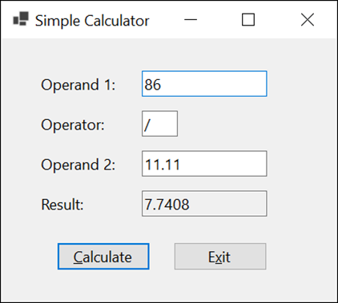
Extra 6-1 Create a simple calculator
Perform an operation using two operands and an operator.

Slide 37

Extra 6-2 Add a method and an event handler to the income tax calculator
Add a method and another event handler to the income tax calculator of extra exercise 5-3.

Slide 38
Objectives (part 1)
Applied
Given the specifications for a method, write the method.
Give the documentation for a method including its signature, use the method.
Give a portion of code that can be converted to a method call and a method, use refactoring to do the conversion.

Slide 39
Objectives (part 2)
Knowledge
Describe the signature of a method.
Describe an expression-bodied method.
Explain the difference between passing an argument by value and by reference.
Describe the use of optional arguments.
Describe the advantages of passing arguments by name.
Describe the use of a tuple as the return type of a method.
In general terms, describe the way event wiring works in C#, what you need to do to delete an event, and how you can use one event handler to handle two or more events.

